Slide 1

Cyclistic Case Study
Analyst: Muhammad Muzammil Khan
March 2023

Slide 2
Hello!
I am Muzammil.
Where to contact me
Linkedin: https://www.linkedin.com/in/muhammad-muzammil-khan-279419257
Email: muzammil.khattak50@gmail.com

Slide 3
Questions
How do annual members and casual riders use Cyclistic bikes differently?
Why would casual riders buy Cyclistic annual memberships?
How can Cyclistic use digital media to influence casual riders to become members?

Slide 4
Tasks(Questions Modified)
Analyze the usage pattern of casual and permanent riders.
Devise a method to convert casual riders into permanent members?
How to use digital media as a marketing tool to promote the company among the people and increase its users?

Slide 5
Types of users
Casual
These are the people who use it occasionally for their own leisure.
They use it more on the weekends as compared to the weekdays.
Members
These are the people who use the service for commuting purposes.
Their usage is mostly same throughout the week.

Slide 6
Data Analysis Results

Slide 7
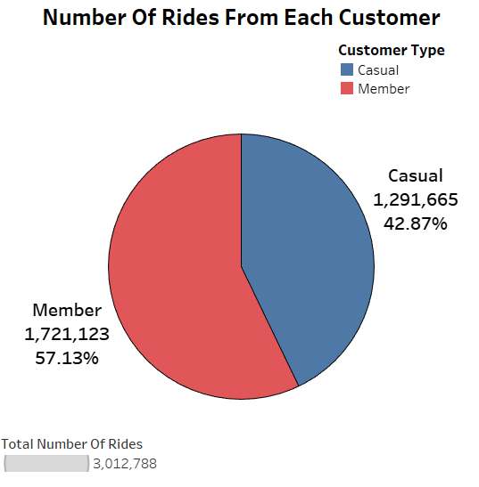
Which type of customer uses the service more?

Slide 8
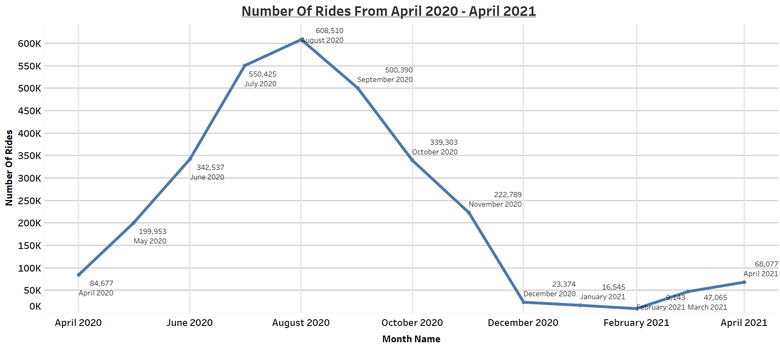
2. Monthly rides

Slide 9
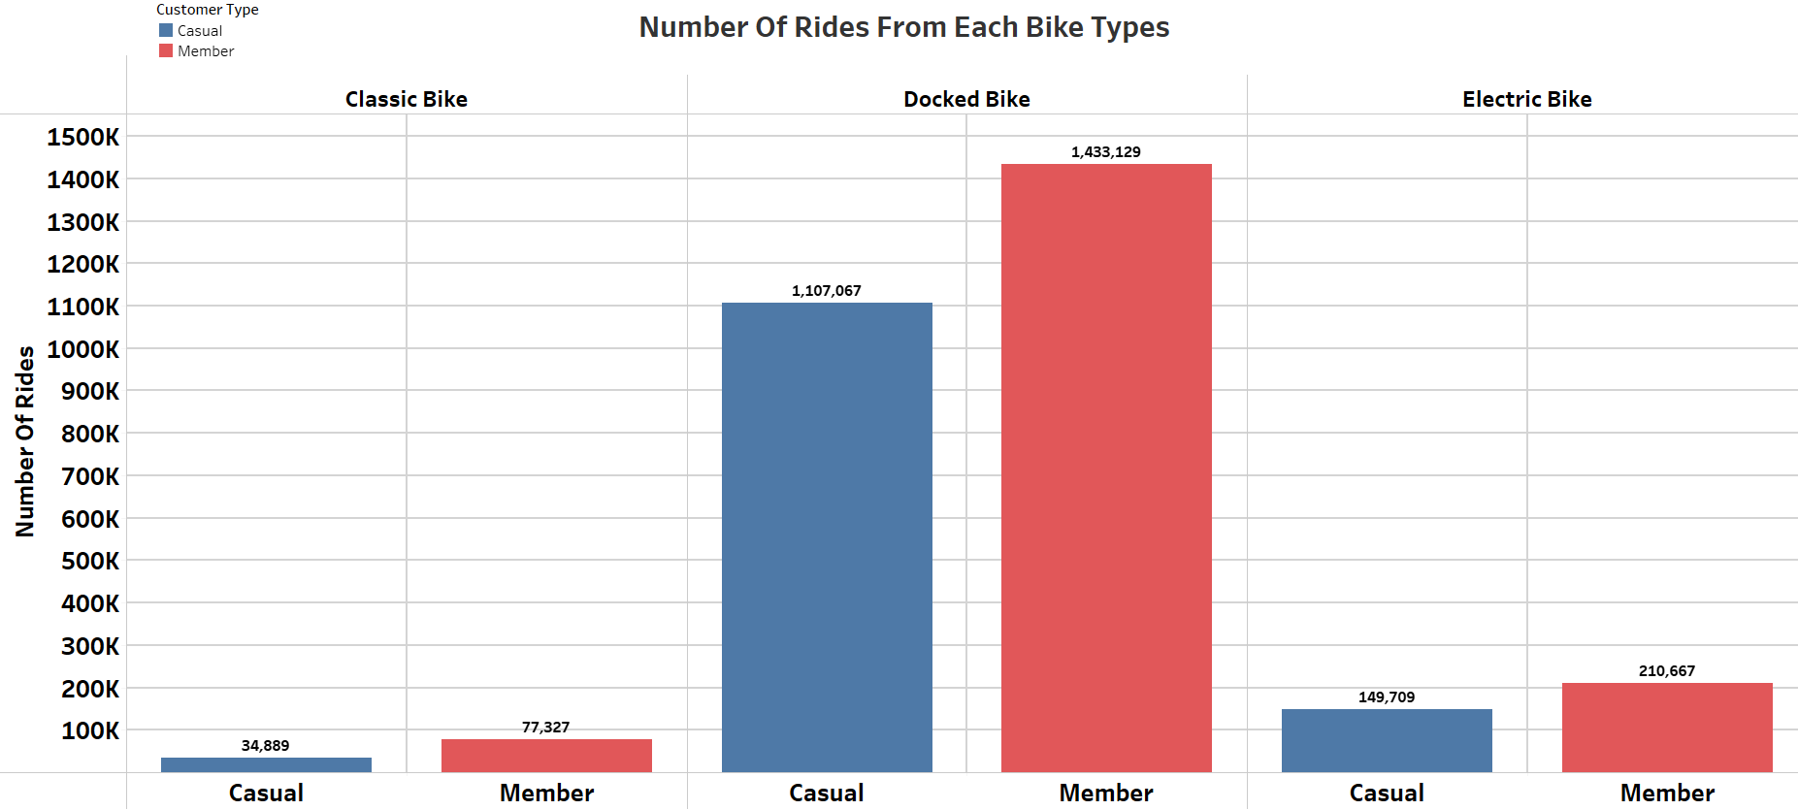
3. What’s the customer favourite?

Slide 10
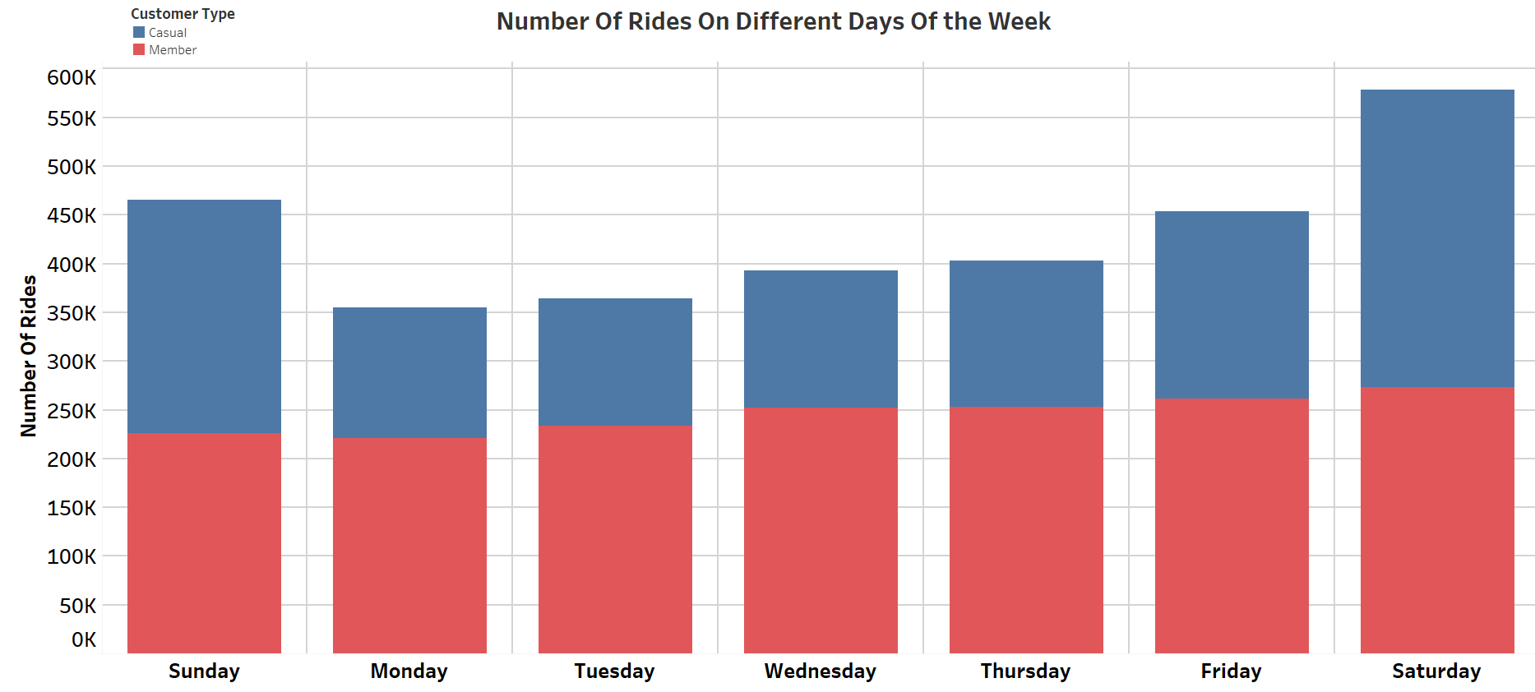
4. What day is the day?

Slide 11
Key Findings/Summary
Permanent members uses the service slightly more than the casual members.
Usage of the service is at its peak during the summer and declines as winter approaches. The usage is minimum in extreme winter and maximum in extreme summer.
Docked bikes are used mostly. They are in high demand by both casual and permanent members. Users seem to be least interested in classic bikes. Electric bikes have a reasonable demand.
Permanent members have constant usage throughout the week because they use the service for commuting purposes. On the other hand, casual members who use the service more for the sake of entertainment rather than for daily commutes appear to have low usage during the weekdays, but on the weekends their usage is the same as that of permanent members.

Slide 12
As the requirements of both types of users are entirely different from each other. Hence, it will not be possible to convert all of the casual members into permanent members.
Some methods can be devised which can boost the overall number of users of the company.

Slide 13
Recommendations
The following recommendations/suggestions are based upon analysis of the data provided by the company. If these recommendations are implemented, they can guarantee financial and long-term benefits for the company.
Increase the number of docked bikes first, then the number of electric bikes
Gradually phase out classic bikes and shift its users to other bikes(electric/docked).
Use digital media to raise awareness about cycling from a health perspective.
Marketing through digital media should be done in winter.

Slide 14
5. Try to introduce additional bike types to give users more variety
6. Membership rates should be different during the summer and winter.

Slide 15
Thank You.

